Slide 1
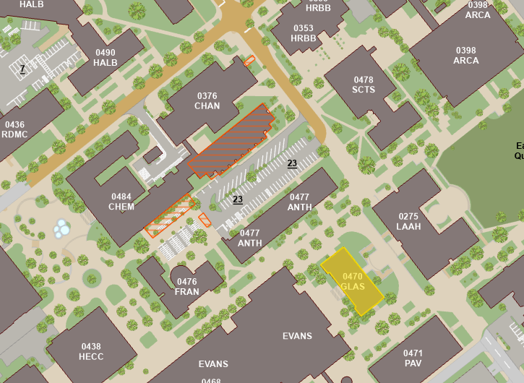

Course Info
Time: MW 4:10-5:25 PM
Location: Chem 100
Instructor: Dr. Lorien Foote
Office: GLASS 211A
Email: lfoote@tamu.edu
Office Hours
MW 10:20-11:20 AM
MW 1:30-2:30 PM
By appointment
Teaching Assistant: John Lewis
Office: GLASS 003B
Email: john-lewis@tamu.edu
Office Hours
TR 10:00-11:00 AM
Grading:
Assignment | Due Date | Max Points
Martin Essay Quiz | Sep. 4 | 25
Sledge Essay Quiz | Oct 30 | 25
Military Image | Nov 20 | 25
Sherman Quiz | Sep 25 | 25
Cordon of Steel MC Quiz | Nov 11 | 10
Soldier Comparison Essay | Dec 6 | 40
Midterm | Oct 9 | 100
Final | Dec 6 (3:30-5:30) | 100

Slide 2
Topics Covered:
Aug 19: Indian Warfare and Adaptation
Aug 21: Colonial Wars
Aug 26: American Revolution
Aug 28: American Revolution
Sep 4: Early Republic
Sep 9: War of 1812
Sep 11: National Expansion
Sep 16: The Mexican War
Sep 18: The Civil War
Sep 23: The Civil War
Sep 25: The Civil War
Sep 30: Reconstruction and Frontier Wars
Oct 2: War for Empire
Oct 9: Midterm
Oct 14: Early 20th Century
Oct 16: The Great War
Oct 21: Inter-War Years
Oct 23: World War II
Oct 28: World War II
Oct 30: World War II
Nov 4: Atomic and Cold War
Nov 6: Korean War
Nov 11: Vietnam
Nov 13: Vietnam
Nov 18: Vietnam
Nov 20: Recovery and End of Cold War
Nov 25: Gulf War
Dec 2: War on Terror

Slide 3
Overarching Questions:
How have Americans applied the concepts of civilization and mortality to how they practice war? How have Americans justified guerilla war and hard war against civilians?
How have Americans conceived of the citizen-soldier vs. the professional soldier?
How have social and cultural forces shaped American military institutions and how Americans practice war? What role have wars played in transforming social life in the United States?
How have military theories, strategies, and tactics changed over time? What factors have contributed to the changes?
How did the enlisted soldier experience duty and combat? How did that experience change and remain the same across time?

Slide 4
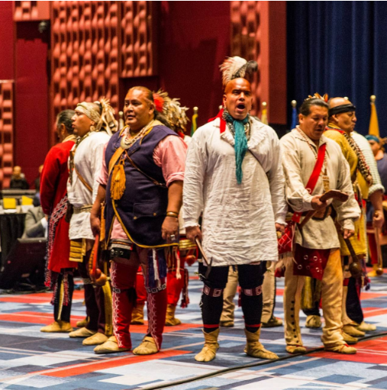
Indigenous Wars
Characterized by conflict between 2 societies with different military cultures
Native Military Culture
Cause For Wars among natives:
Revenge against another tribe for killing one of their own
Taking captives to replace that lost member
Native battle Tactics
Focused on ambush to surprise enemy and get captives
Parties usually consist of a few people with good senses
Communicate with accurate animal sounds
Attack with tomahawks and knives
Masters of concealment
Hand-to-Hand combat
Important to natives because the only way to become a “man” was to participate in hand to hand-to-hand combat
Torture
Natives viewed resisting torture as manly. Dying while resisting torture was a great honor.
Europeans viewed torture as savage.

Slide 5
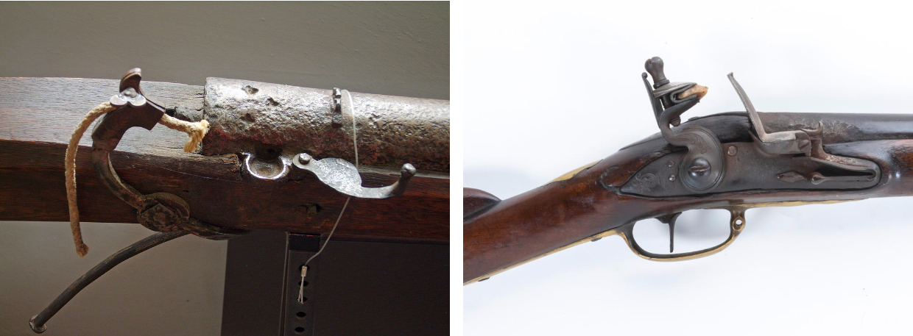
European Military Culture
English military culture is characterized by a fear of standing armies
Standing armies were viewed as tyrannical and against liberty
Instead, militias were used, and war was supposed to be fought by the people
Every man would participate in drills every other month
English line tactics
Men would stand shoulder-to-shoulder and fire timed volleys at the enemy to instill shock
A lot of precision and training were necessary to perform effectively
Common weapons during this time were the matchlock, and later, the flintlock
Colonial adaptations
Tidewater War (Virginia, 1622-1632)
On March 22nd, 1622, Natives ambushed settlements in Virginia, killing 25% of the population.
Colonists would march into the woods asking for battle but were only met with more ambushes and laughter.
Made the colonists realize they were vulnerable to native tactics
Colonials trying to adapt
Create strongholds and defenses to protect people
Natives would not put the defenses under siege, leading to a waste of time and resources
Create a defensive line and forts
Natives could easily sneak through the line with concealment
Create rangers
Semi useful, could report whereabouts of natives

Slide 6
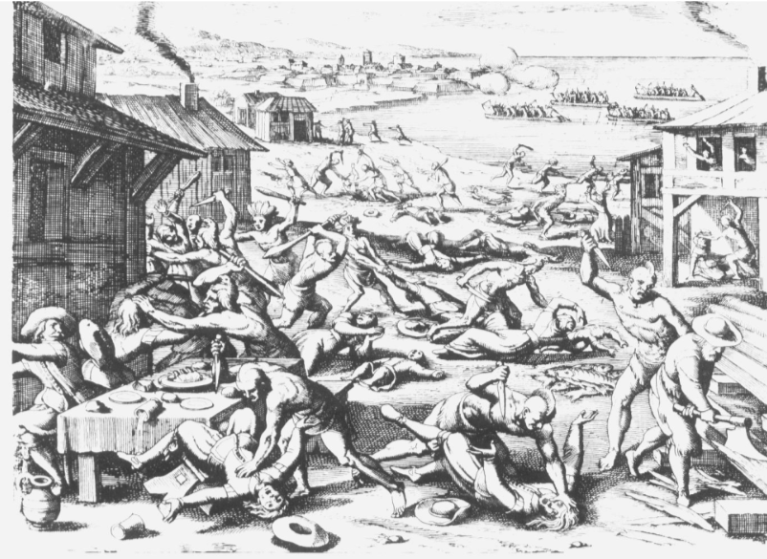
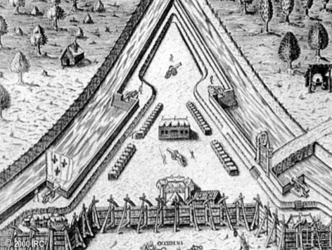
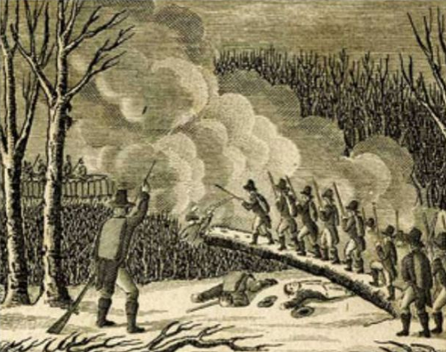
Successful Adaptations during Tidewater War:
Create alliances with other natives to have them reveal settlements to the colonists
Use this information to destroy food supplies, crippling natives
Use ambush tactics of their own by hiding behind trees and firing
King Phillip’s War (New England, 1675-1676)
Bloodiest war in American history (by percentages)
40% of natives died, 5% of English colonists
Started with the devastation of New England towns by the Wampanoag
English use their new tactics to go and destroy native towns
Battle of great swamp (1676)
Fearing an attack next year, the colonists made a preemptive attack on the natives during the winter
The entire village was burnt to the ground

Slide 7
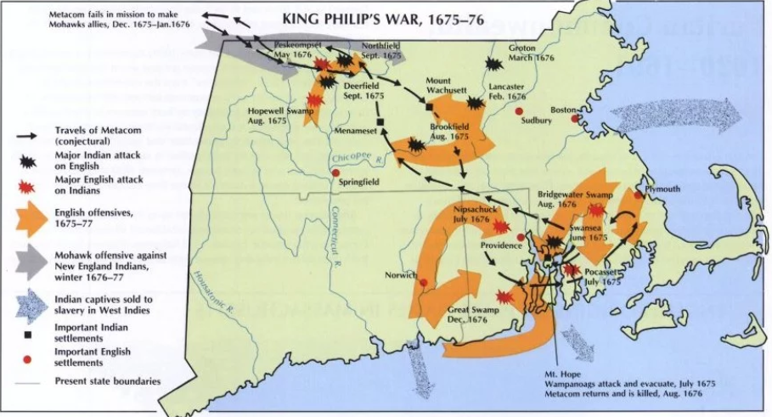
Colonial Adaptation: Benjamin Church
Benjamin church got permission to make a militia that fought like the natives.
The ambush tactics used were very successful
Native Adaptation: Volley fire
During one example, Benjamin Church’s group encountered a native unit that ambushed them with volley fire.
Outcome from the war
Many accounts of the war were created for the time.
This was the start of the colonists viewing themselves as Americans
Led to the natives being viewed as savages
Significance to question 1 of the overarching questions
The enemies were savages, the only way that they could be beat was to adapt their savage tactics

Slide 8
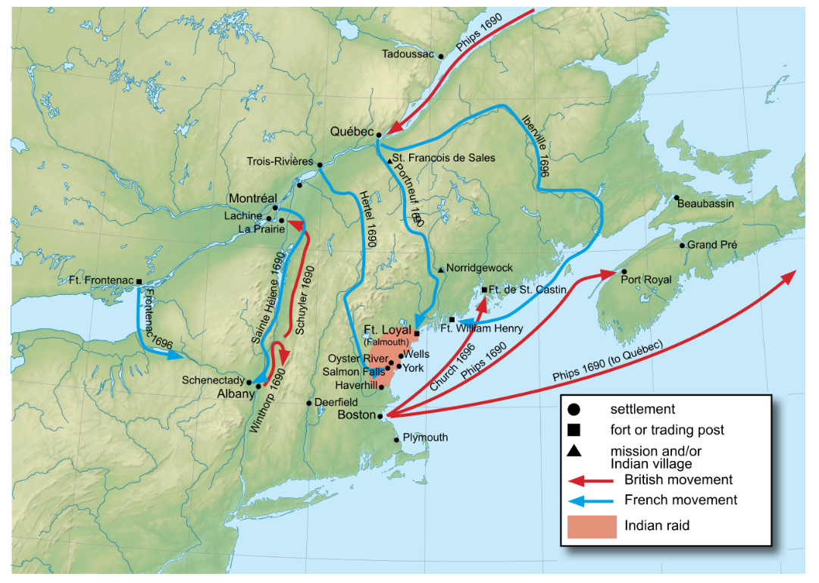
Colonial Wars
Characterized by the sowing of discontent between colonists and the British
British advantages over the French
England had the most dominant navy in the world
The British colonies were much more populated and developed than the French ones
British were focused on agriculture while French were focused on fur trading
King William’s War (1689-1697)
French and Natives strike New England and New York
Leads to colonists meeting to develop a plan to attack Canada
Create a plan called “The Blueprint” with two groups
One would be land based that would set out from Albany, head North past Lake Champlain, and strike Montréal
The other would be sea based, head out of Boston, go through the Gulf of St. Lawrence, go down the St. Lawrence River, and strike Québec
The blueprint couldn’t be used due to a lack of resources
The rest of the war consisted of border raiding
The treaty reinstated the status-quo

Slide 9
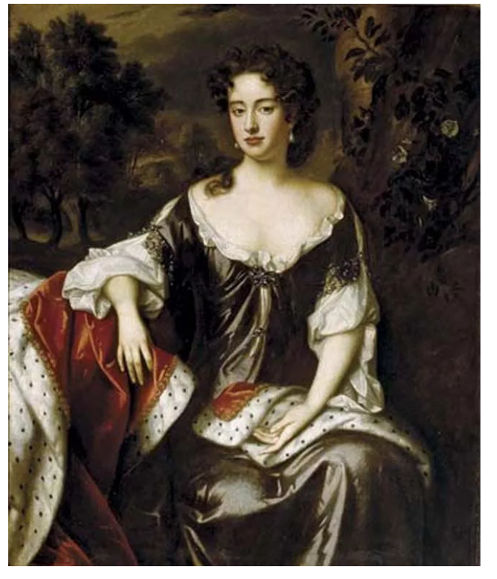
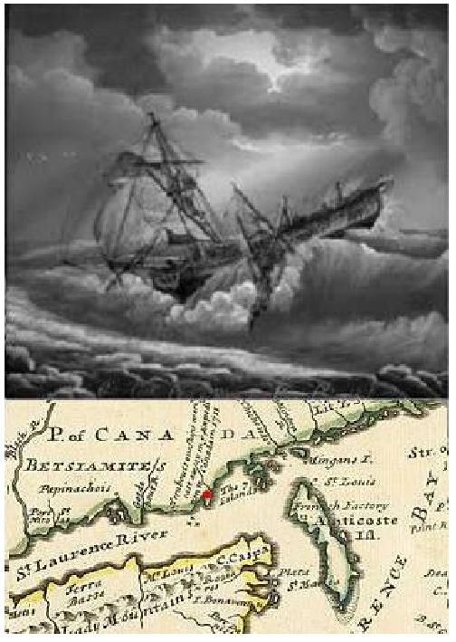
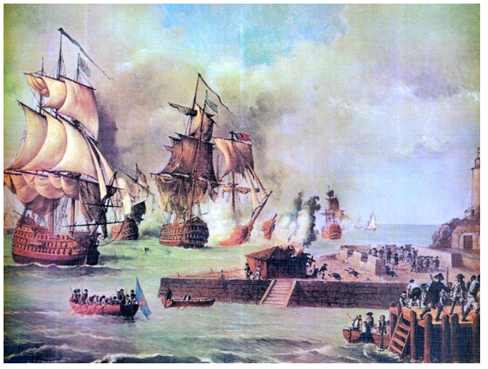
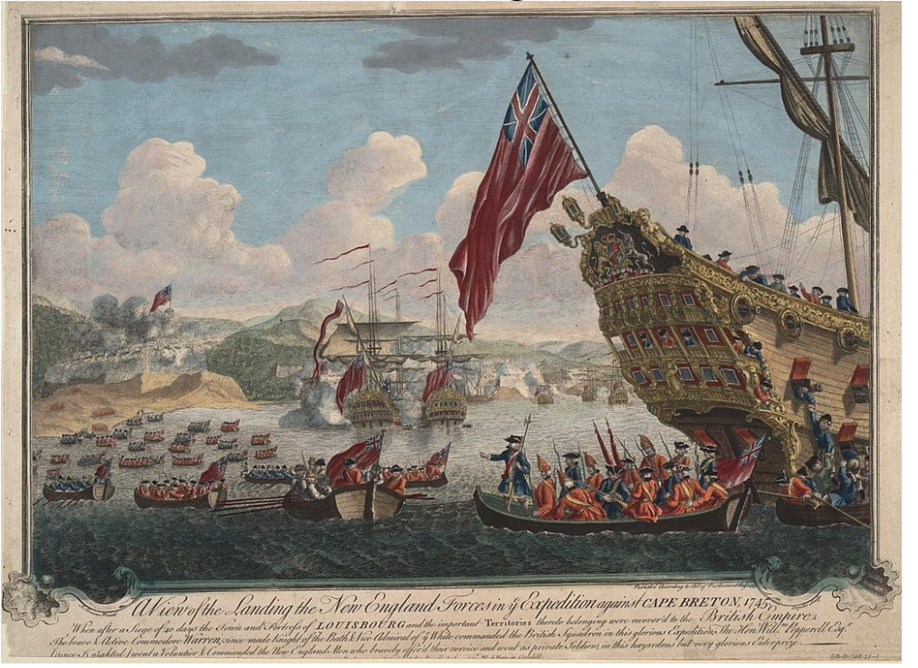
Queen Anne’s War (1702-1713)
Colonists wanted help from the British to go through with their blueprint, but the British cared more about Europe
However, in 1709, the British told the colonists they were planning on coming to help.
2,000 militia men gathered waiting for the British, but the British ended up canceling the expedition
In 1711, another expedition was planned and to be led by Hovenden Walker
The sea group consisted of 9 ships of war, 60 transports and 12,000 troops
The planned was started, but a storm ravaged the sea group. This led to 8 transports running aground, killing ~1,000 men
Walker cancelled the expedition after this.
The colonists were mad the British turned around, and the British didn’t like the colonists
King George’s War (1744-1748) (France and Spain)
British put together a large task force to attack Cartagena (Colombia), and the colonists sent some men to help
The British treated the colonists poorly, giving them the worst supplied and making them do fatigue duties (dirty work).
On top of that, the expedition failed.
Near the end of the war, the colonists planned an attack on Louisburg, a large fortress that could attack ships going to the Gulf of St. Lawrence.
They could do this because the fort was lightly defended at the time.
The colonists captured the fort and held it until the end of the war
However, in the treaty, they had to give it back to the French.

Slide 10
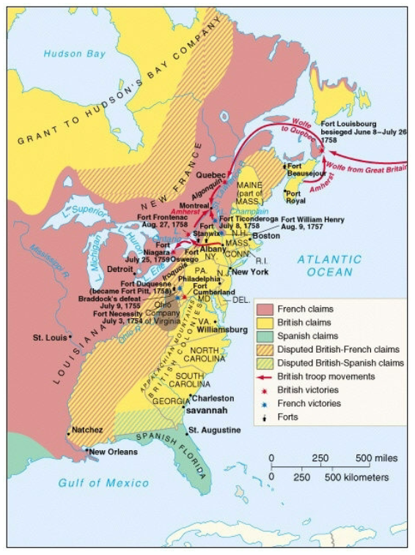
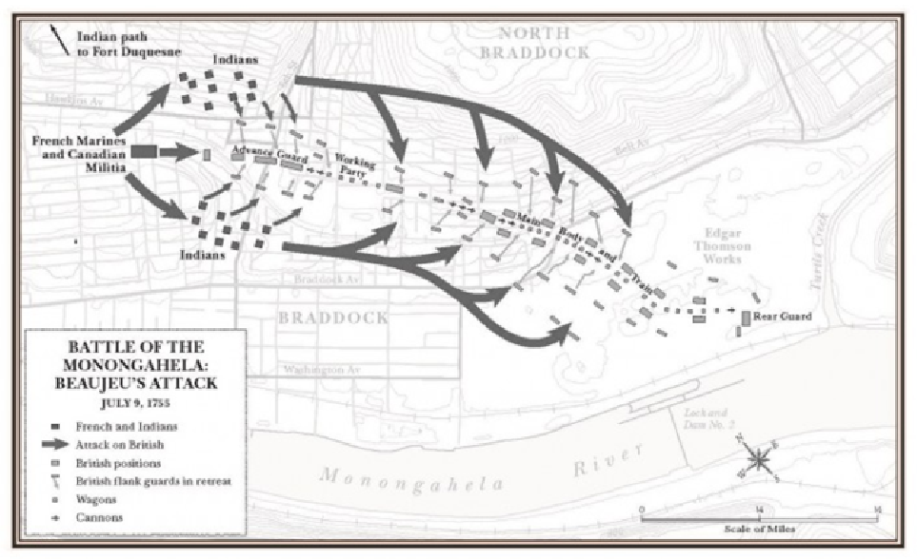
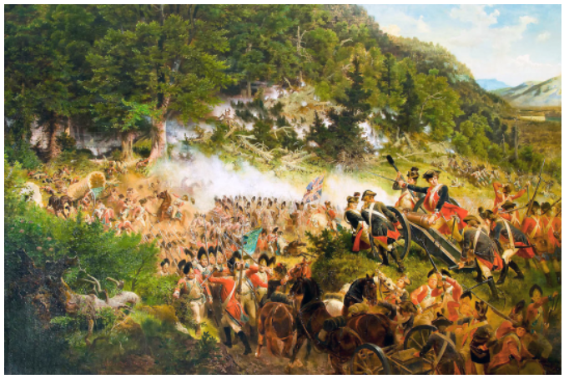
French and Indian War (AKA The Seven Years War) (1754-1763)
Started when a group led by George Washington, that was supposed to scout French forts, engaged a French force. One of the Indians that was with the British killed a French man and humiliated him.
The first major British attack on the French forts came with the attack on Fort Duquesne (Pittsburgh). It was led by Edward Braddock
He led a group of 2,200 soldiers (mostly British)
The whole reason this attack could happen was because Benjamin Franklin got a bunch of horses for them to use.
Braddock sent an advance column to attack the fort.
Battle of Monongahela
Due to his Indian allies, French commander Daniel Beaujeu knew it was coming.
He surprised the British by having the French attack the front, and his Indian allies attacking the flank.
The British were caught off guard and sustained heavy casualties. They tried to make formations they would use in Europe, but it wouldn’t work.
The Americans scattered and hit behind rocks and trees. They covered for retreating Brits.
This led to the Americans thinking they were better fighters than the British. This battle was taught to young colonists, further seeding bad blood between the two.

Slide 11
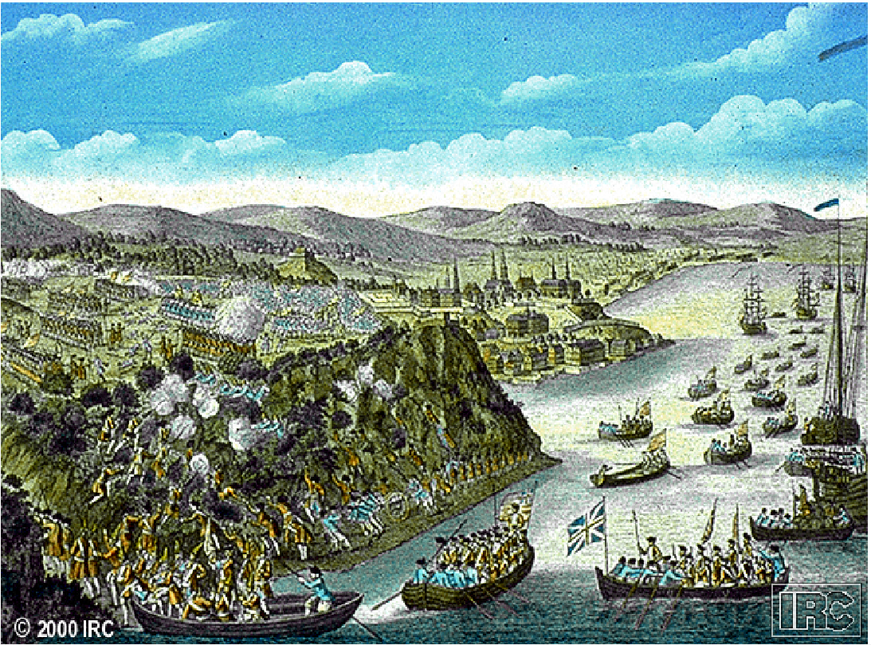
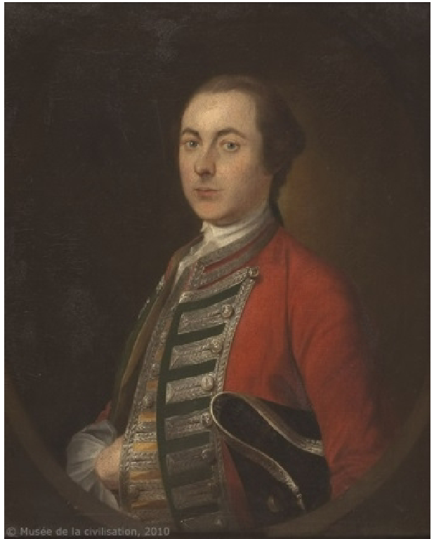
British turning around the war:
William Pitt became prime minister halfway through the war, and had a different strategy to win
He would finance the Prussians in Europe but send the British military resources to North America.
He also wanted to use the blueprint to attack Canada
His first course of action was to blockade Canada, and that worked.
James Wolfe was sent to lead the attack on Québec
1/4th of the navy was sent, and 8,500 men.
He had troubles attacking The fort in Québec and was running out of ideas. However, an American POW escaped the fort and told him of a secret path they could take to attack the city from behind
Wolfe used this information, and at night, transported his troops to the lakeside, and had them all climb up a cliff to attack the city.
At morning, the Battle of the Plains of Abraham took place
The Marquis de Montcalm saw them in the morning and sent his troops to engage them.
The French lost embarrassingly, as most of their troops were undisciplined.
Despite this big win, British and colonial relations were still strained
Throughout the war, the British sent letters back home saying the Americans were undisciplined and cowardly
They would not head into Canada, because their contracts said they were enlisted for 3 months in their homeland
Americans were mad because the British professional soldiers had to stay in their homes. They were low-class and caused trouble.

Slide 12
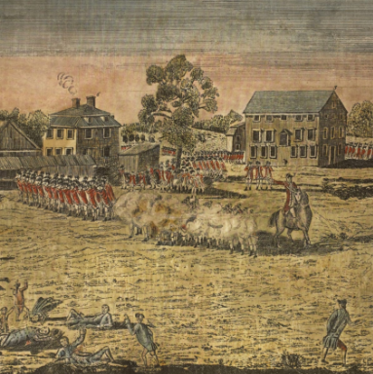
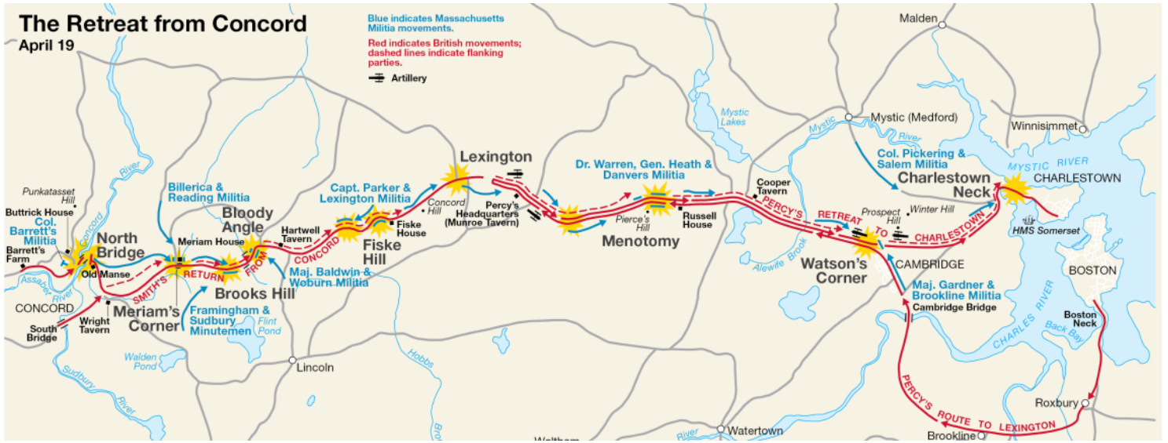
American Revolution: Part 1
The composition of the revolutionary army and Washington’s strategy
Start of the war characterized by local military decisions
Colonists don’t have a decided goal yet, and the British don’t believe they will have to have a serious conflict with the colonists
Battle of Lexington and Concord
Thomas Gage hears of militia stockpiling of supplies in Lexington and Concord.
Heads out from Boston with plans to take the weapons and arrest the leaders
When the British get to Lexington, 70 militia men are there to meet them
Initially, the man in charges tells the rebels to disarm and leave
British military officers are cursing at the militia men
Eventually, someone fires, and fighting ensues
British achieve their goals and head to concord
Other militia men hear of what the British have done, so they decide to attack them (minutemen)
On the way back from Concord, British are under constant attack from the Colonists.
Called the “Second battle of Monongahela”
Eventually, the British find their way back to Boston and stay there
The colonists can’t take the city because there’s only one way in or out.

Slide 13
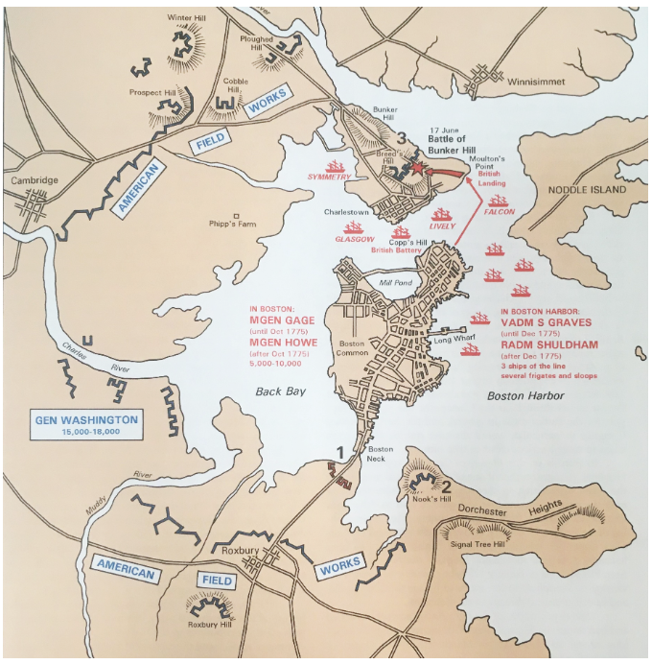
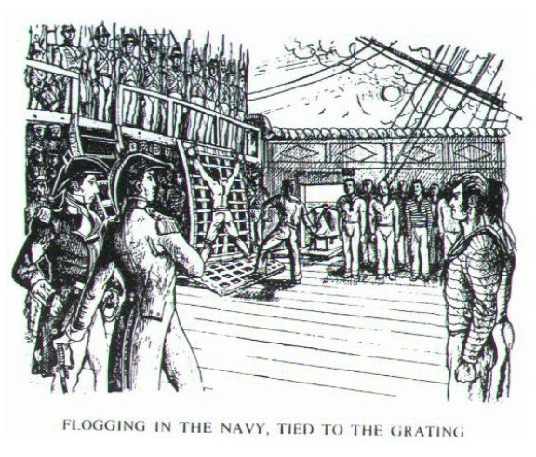
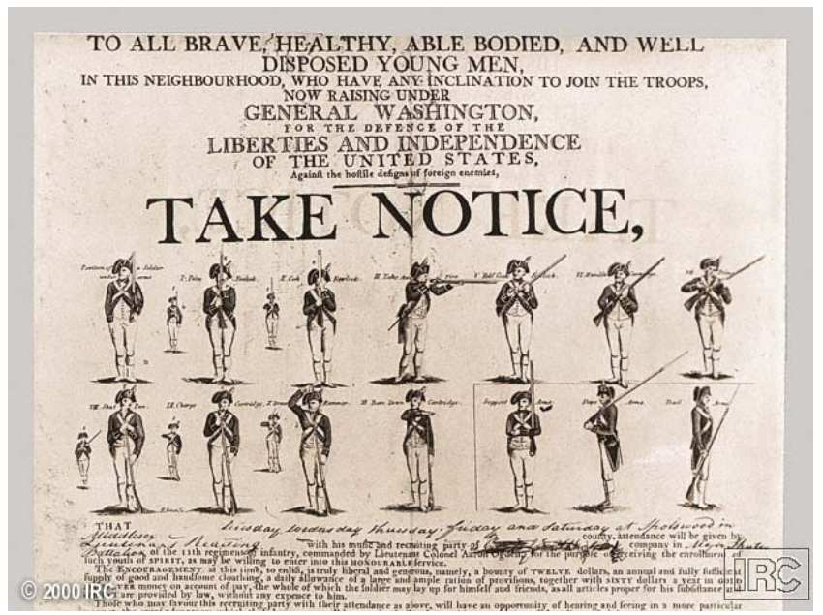
Unable to take Boston, Ethan Allen and a militia decide to attack Fort Ticonderoga to get supplies
Meanwhile, the Continental Congress is underway, and they want to create a more unified response against the British and not just rely on whatever the militiamen are doing
Decide to make Washington the leader of this army
Initially composed of the Massachusetts Militia, but forces from Pennsylvania, New York, and Virginia added.
Due to American suspicions of central authority, the only way to get funds was by the states asking for money
This led to soldiers not being paid and not getting good supplies
Continental army composition:
Officers are wealthy upper-class while enlisted men are lower-class
Very diverse. Many black men, Germans and Irish
Officers come from gentlemanly class
They have etiquette and honor
Honor in this time is seen as your social self worth
If you are not respected by your peers, you have no honor
While a common punishment for disobedient enlisted men would be flogging, a punishment for an officer would be the stripping of rank (social exclusion)
Washington basically adopts the British articles of war, in which, officers must act gentlemanly

Slide 14
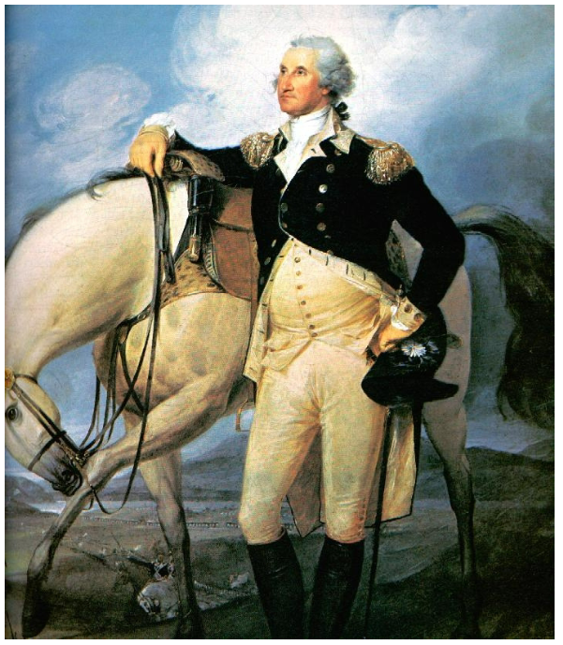
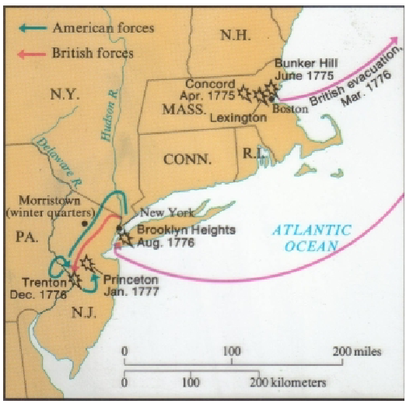
State Militia
Mostly upper class
Officers are elected, so they treat their men well
Fight in an unconventional style (ambushes and firing from behind cover)
Washington’s Strategy
Initially, Washington wanted to make a conventional army that fought with linear tactics
This was to try and convince Europeans that America was civilized, so they could get funding
Tries to defend long Island, but that fails miserably
Troops are untrained and undisciplined
New strategy: Erosion
If he keeps the army alive and in the field, the British can’t win the war
Try to get the British to lose the will to fight
Inflict small casualties on the British for an extended period while avoiding large battles
To make this work, he create a spy network to get whereabouts of British movements
Some issues with this strategy:
Keeping morale of troops and keeping morale of citizens
Dec 76’: 3,000 troops in NY with bad morale. Just lost long island
Spy network notifies Washington that British mercenaries are hunkering down in New Jersey for the Winter

Slide 15
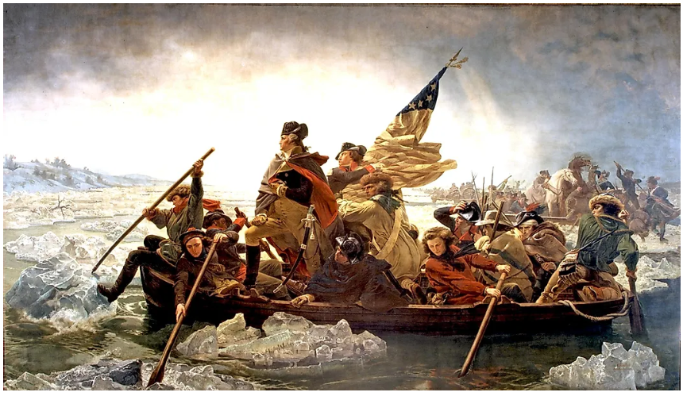
Washington crosses the Delaware with his troops and completes a route at Trenton. He quickly retreats across the river again
Spy network reveals that 6,000 troops are looking for his army
So, he crosses the river again and takes out a small detachment of that 6,000
British (lack of) strategy
Switching between two main options: being benevolent and destroying rebels
No command structure, causing big problems
Saratoga
Edward Burgoyne develops a strategy to eliminate the rebels: use their blueprint in reverse
Plans on heading down towards Albany from Canada and having William Howe go North from New York City
Howe does not go North from New York City, instead going to Philadelphia
Burgoyne ends up taking a long time to head South. This is due to his own slowness and rebels blocking the path by destroying the path
This leads to him sending out detachments to forage, which get intercepted by militia men
Knowing that Saratoga is more important than what Washington is doing, he sends his best units North to help. (Horatio Gates leads this)
Gates engages Burgoyne and militia surround him
This leads to Burgoyne surrendering

Slide 16
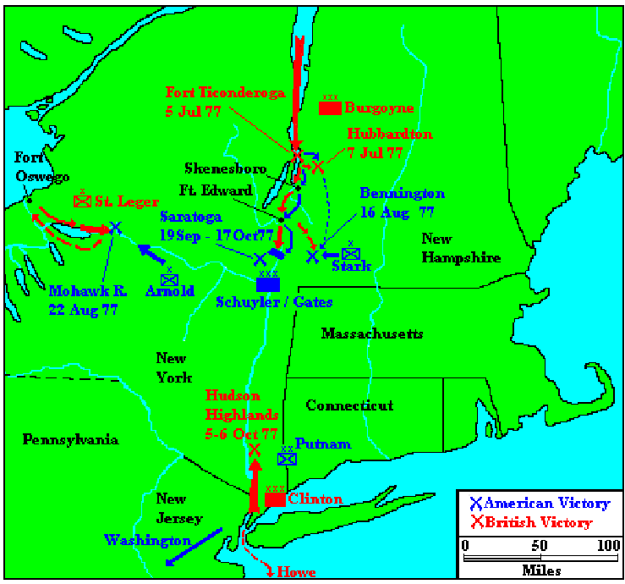
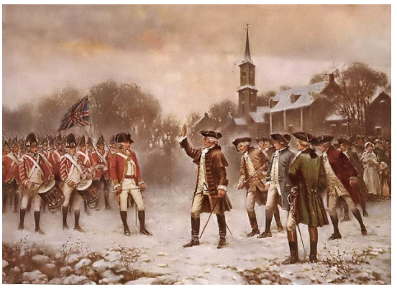
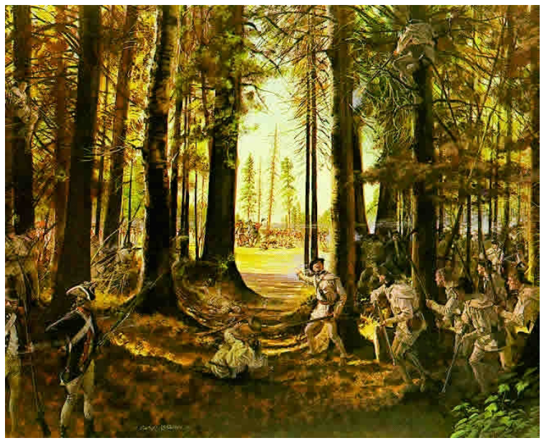
Consequences from Saratoga
Support for the war in England plummets. After 2 years, there is no progress
Convinces the French that the Americans can win
The French agree to fight Britain until the colonies gain independence
Turns this into a world war for the British
French navy comes to help the Americans
Convinces Washington he can risk a large battle with the British

Slide 17
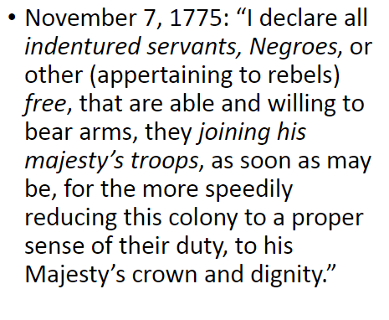
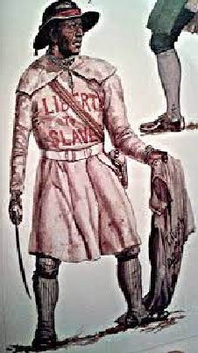
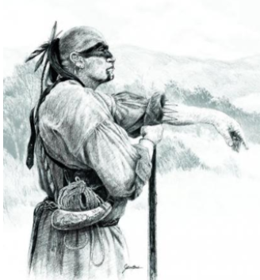
American Revolution: Part 2
Civil war and Nathaniel Greene
Loyalists
Patriots not only have to fight the British, but loyalists, blacks and Natives too
Dunmore’s Proclamation stated that all slaves and indentured servants that fought for the British would be free after the war
Cornelius Titus – Leader of Black Brigade
Took up on Dunmore’s proclamation and lead a group of slaves, indentured servants, and natives
Started a guerrilla war in Monmouth county New Jersey
Guerilla war is when a small groups of people use unconventional tactics to disrupt enemy operations
Cherokee war of 1776
Dragging Canoe sees that the revolution is occurring and knows this is his chance to defend themselves against settlers
Gets many villages together to destroy settlements in Virginia, North Carolina, South Carolina, and Georgia
Major successes in South Carolina and Georgia
Patriot campaign sees militias stop a lot of the progress Dragging Canoe makes
In the end, the Cherokee are forced to cede more land

Slide 18
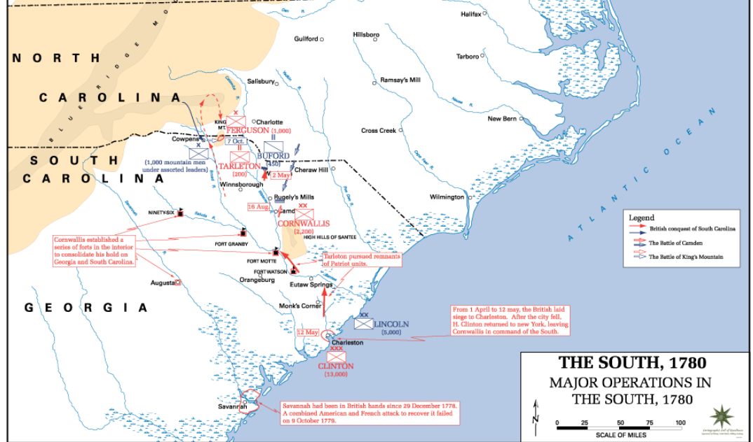
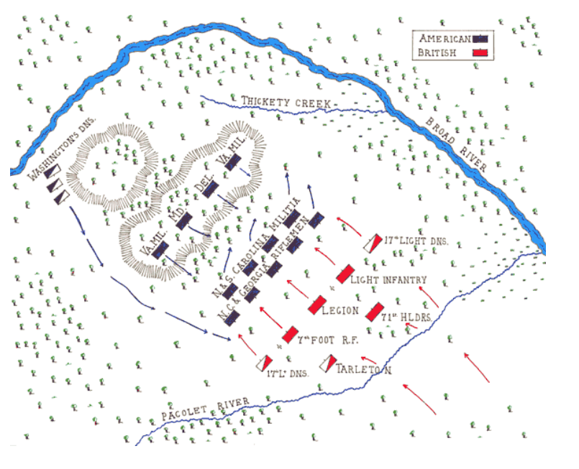
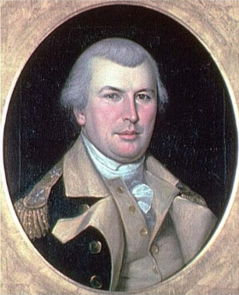
British shift focus to the South in 1780
Captured lands and forts in South Carolina and Georgia
Many British soldiers and officers did bad things because they were mad the war had gone on so long
Many patriot Guerrillas were present in these states
Nathaniel Greene
He was Washington’s quartermaster
When Washington promoted him, he was mad, but he accepted anyway
His strategy to get rid of the British
Try to coordinate with the guerillas as well as possible by encouraging the British to send out small detachments
He did this by splitting up his forces, which was contrary to the military strategy at the time
This led to the British splitting up to look for him, often sending out small detachments.

Slide 19
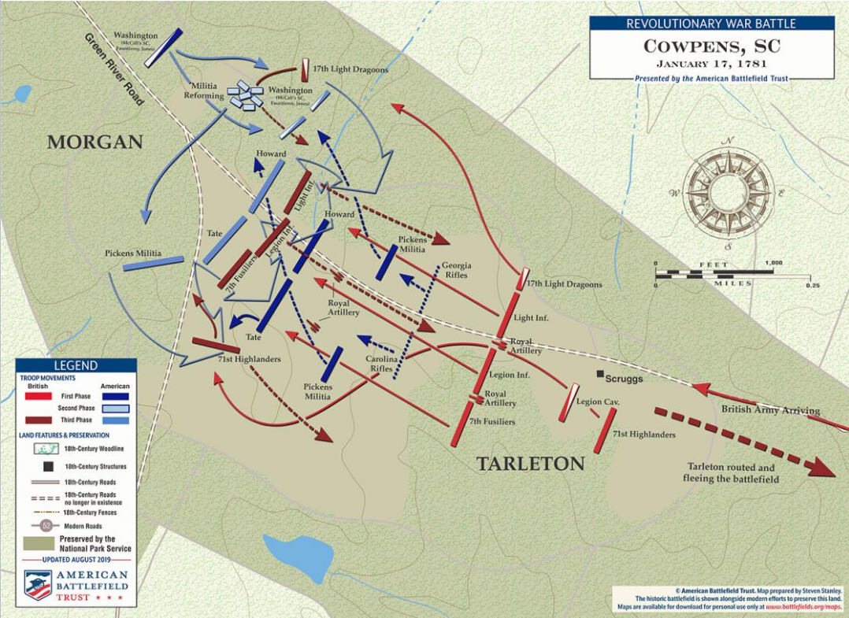
Daniel Morgan and the Battle of Cowpens
Daniel Morgan was at the battle of Monongahela
As his time serving under the British, he was lashed 100 times
However, the lasher missed the last one. This made him say “I’ll give the last one back to the British”
He had 1,000 troops under his command
Both continental trained troops and untrained militia troops
Morgan’s battleplan for Cowpens
Have 3 lines of troops: a row of sharpshooters to try and kill officers, a row of militia men, and a row of his continental troops
Battle of Cowpens
Tarleton's British army attacks Morgan
After the British get close, the sharpshooters fire and retreat to the 2nd line
The second line fires 2 volleys and retreats
British dragoons follow the militia men
Morgan’s dragoons cover the militiamen, so they can recover
British line and continental line start fighting
Tarleton sends in his highlanders, so a patriot general orders the men to change position
Some men think this is a retreat order, which leads the British line to do a full attack
Continentals regain organization and with the help of the militia men, they envelope the British
The British suffer 90% casualties

Slide 20
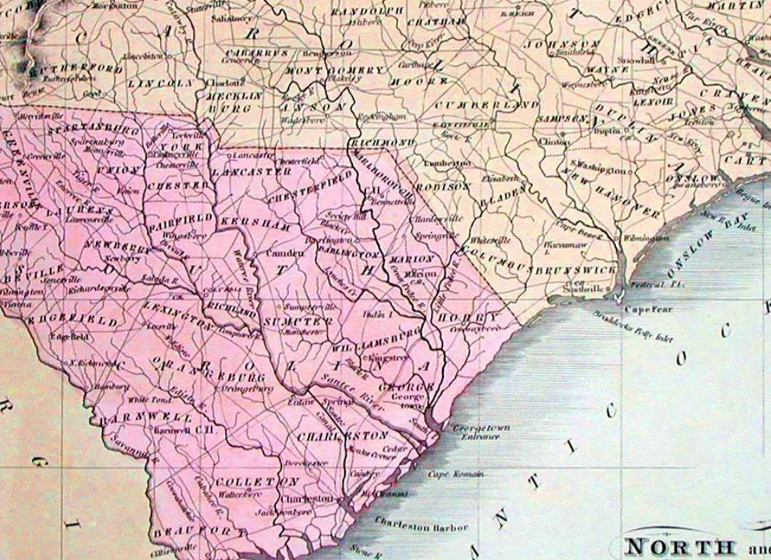
After Cowpens, Greene orders his armies to concentrate so they can retreat to Virginia
This causes Cornwallis, who was the British commander, to chase him
Due to Morgan’s time as a quartermaster, his army is more organized and able to outrun the British
This causes Cornwallis to burn their baggage to move faster
At this point, Morgan knows he has a strategic victory, even if he can’t win the battle
Due to the loss of supplies, the British need to forage for food, leaving them open to attacks from the guerrillas
Morgan is still able to move faster than the British, and he eggs the British on by purposefully going slower, to give the British hope
Eventually, they fight in Virginia and Morgan loses
However, the British suffer massive casualties. Due to their lack of supplies, they need to travel back to the coast to get aid from the Royal Navy

